Slide 1



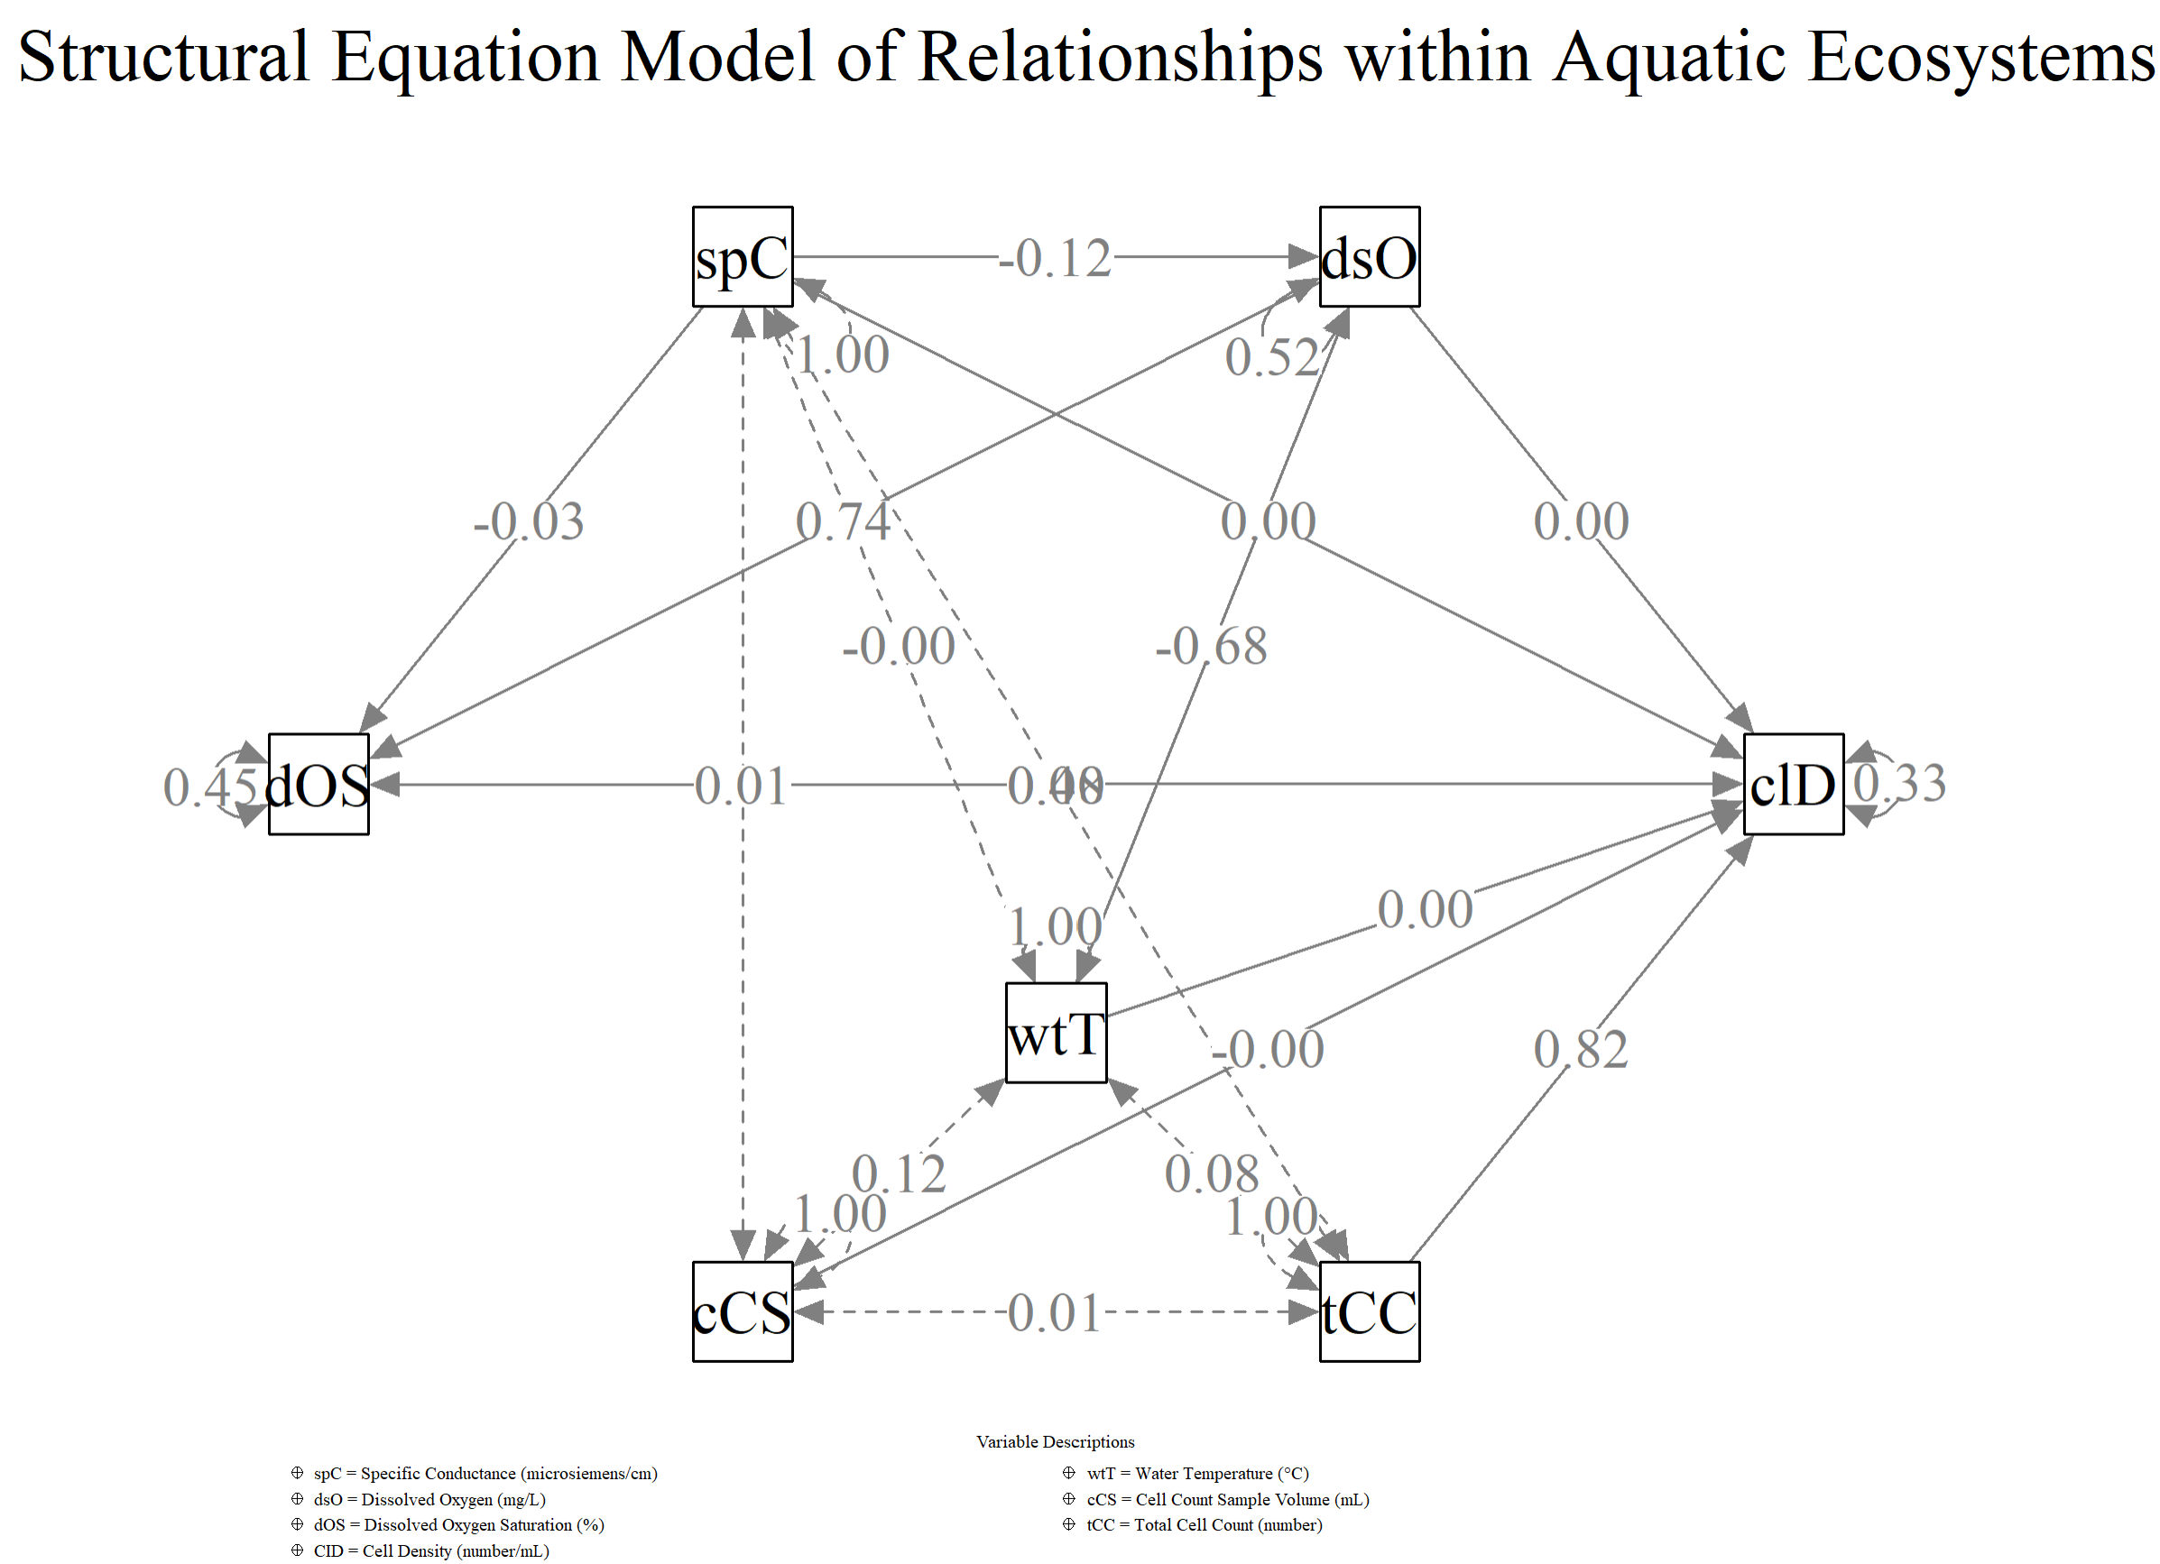
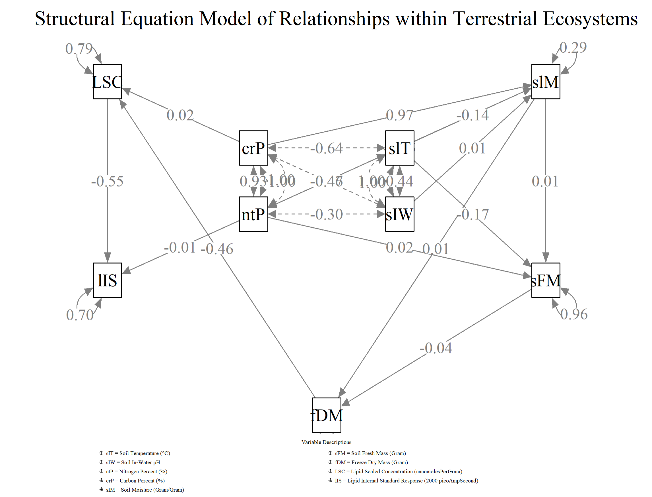
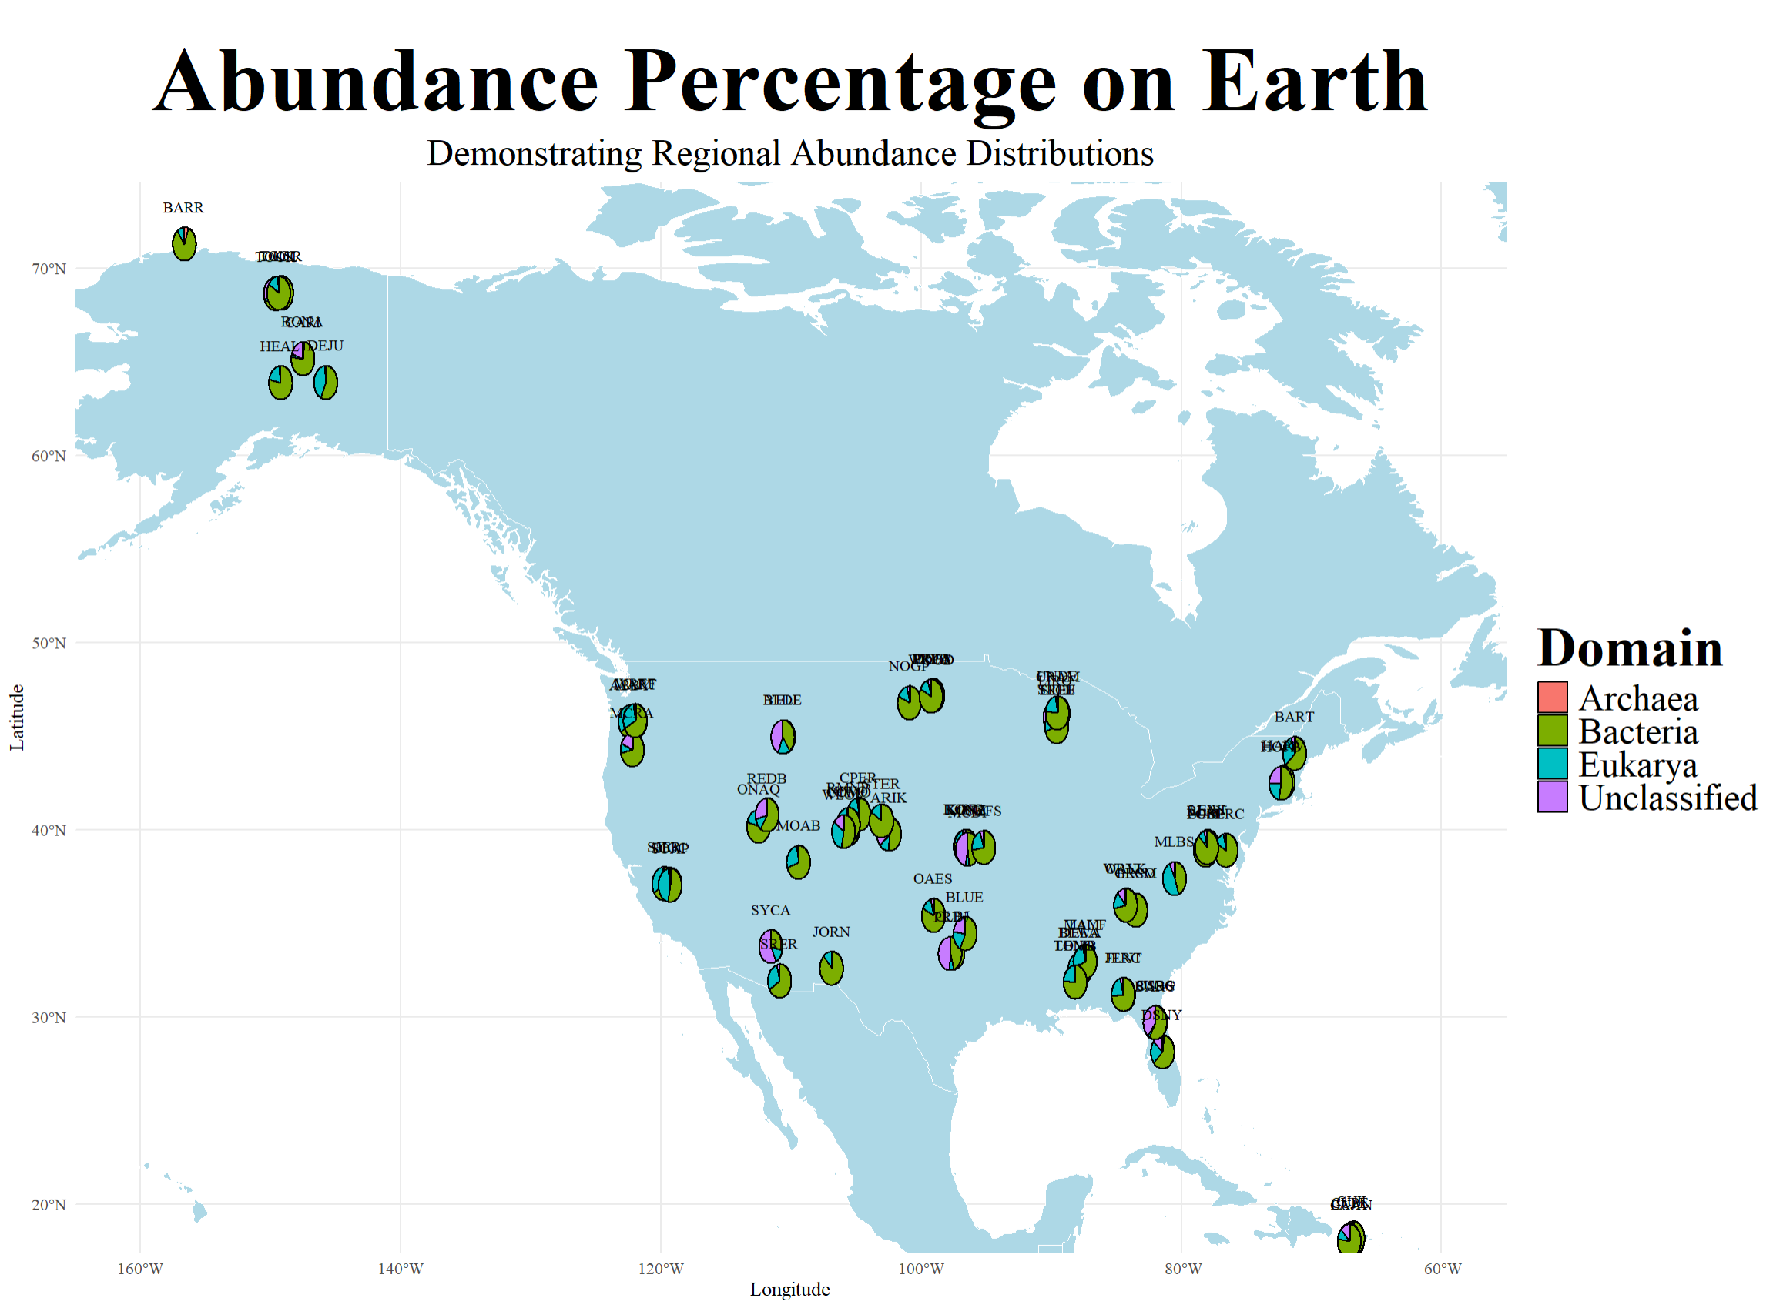
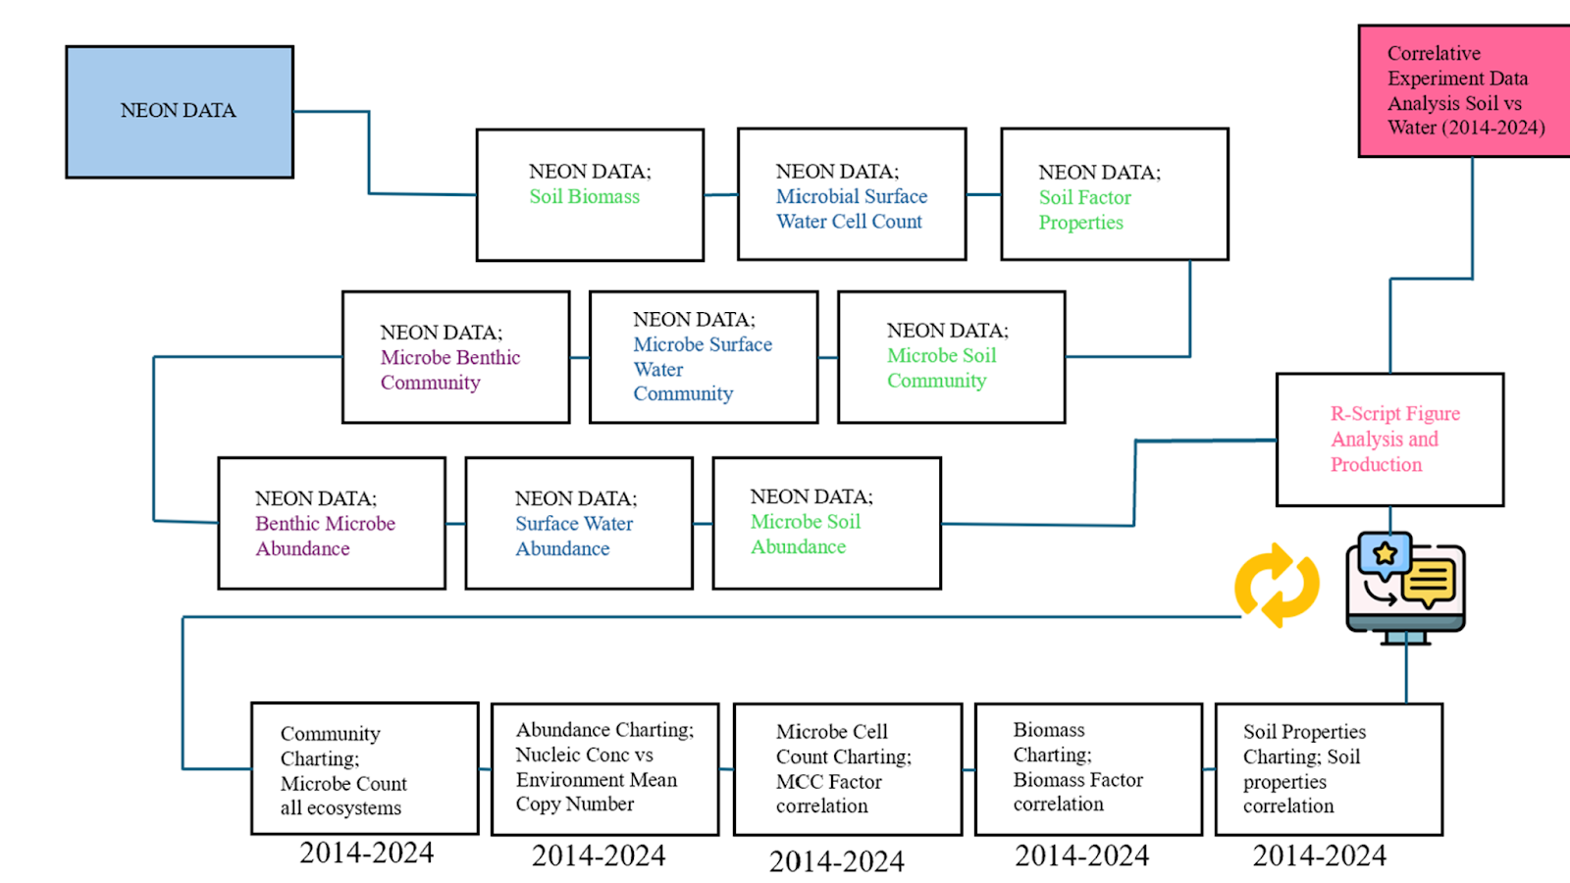
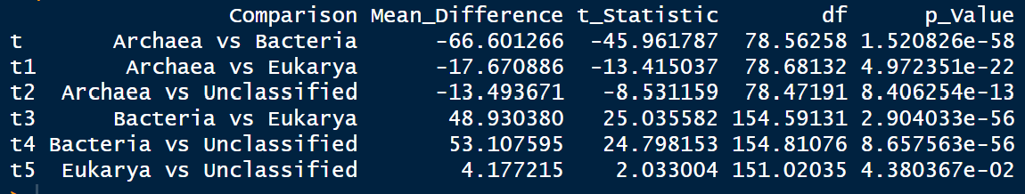
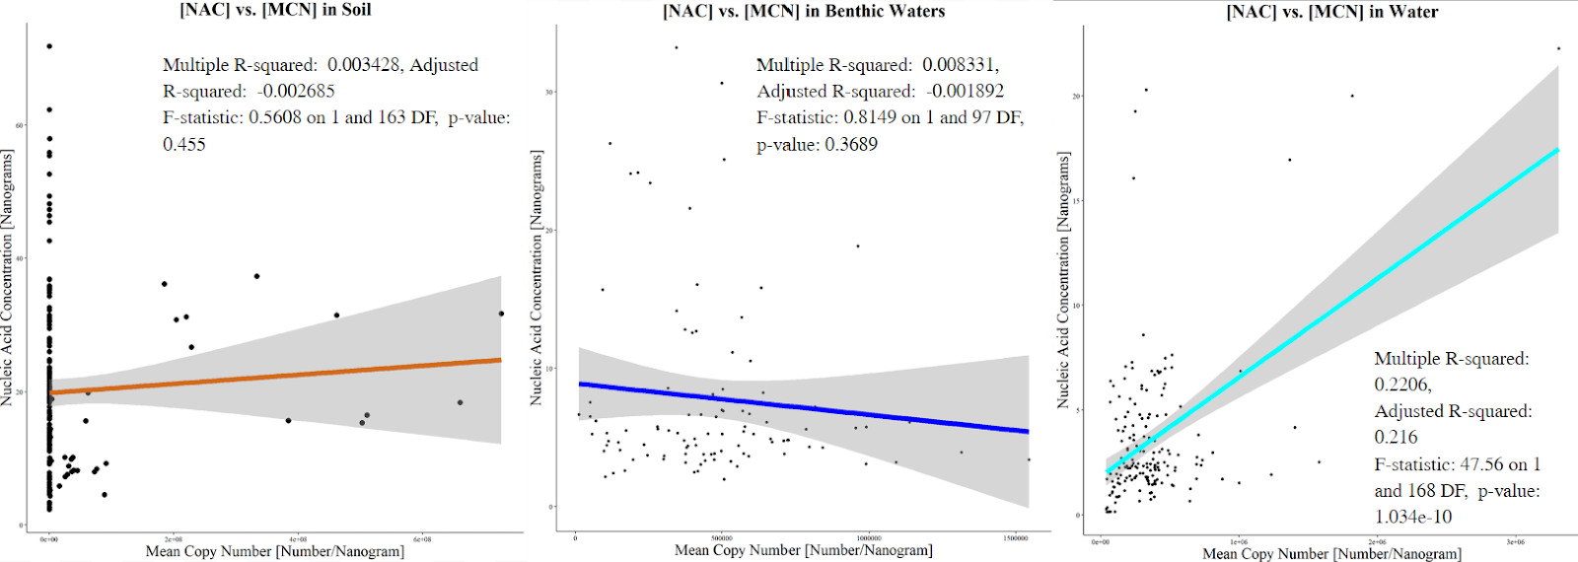
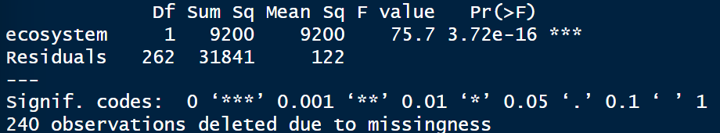
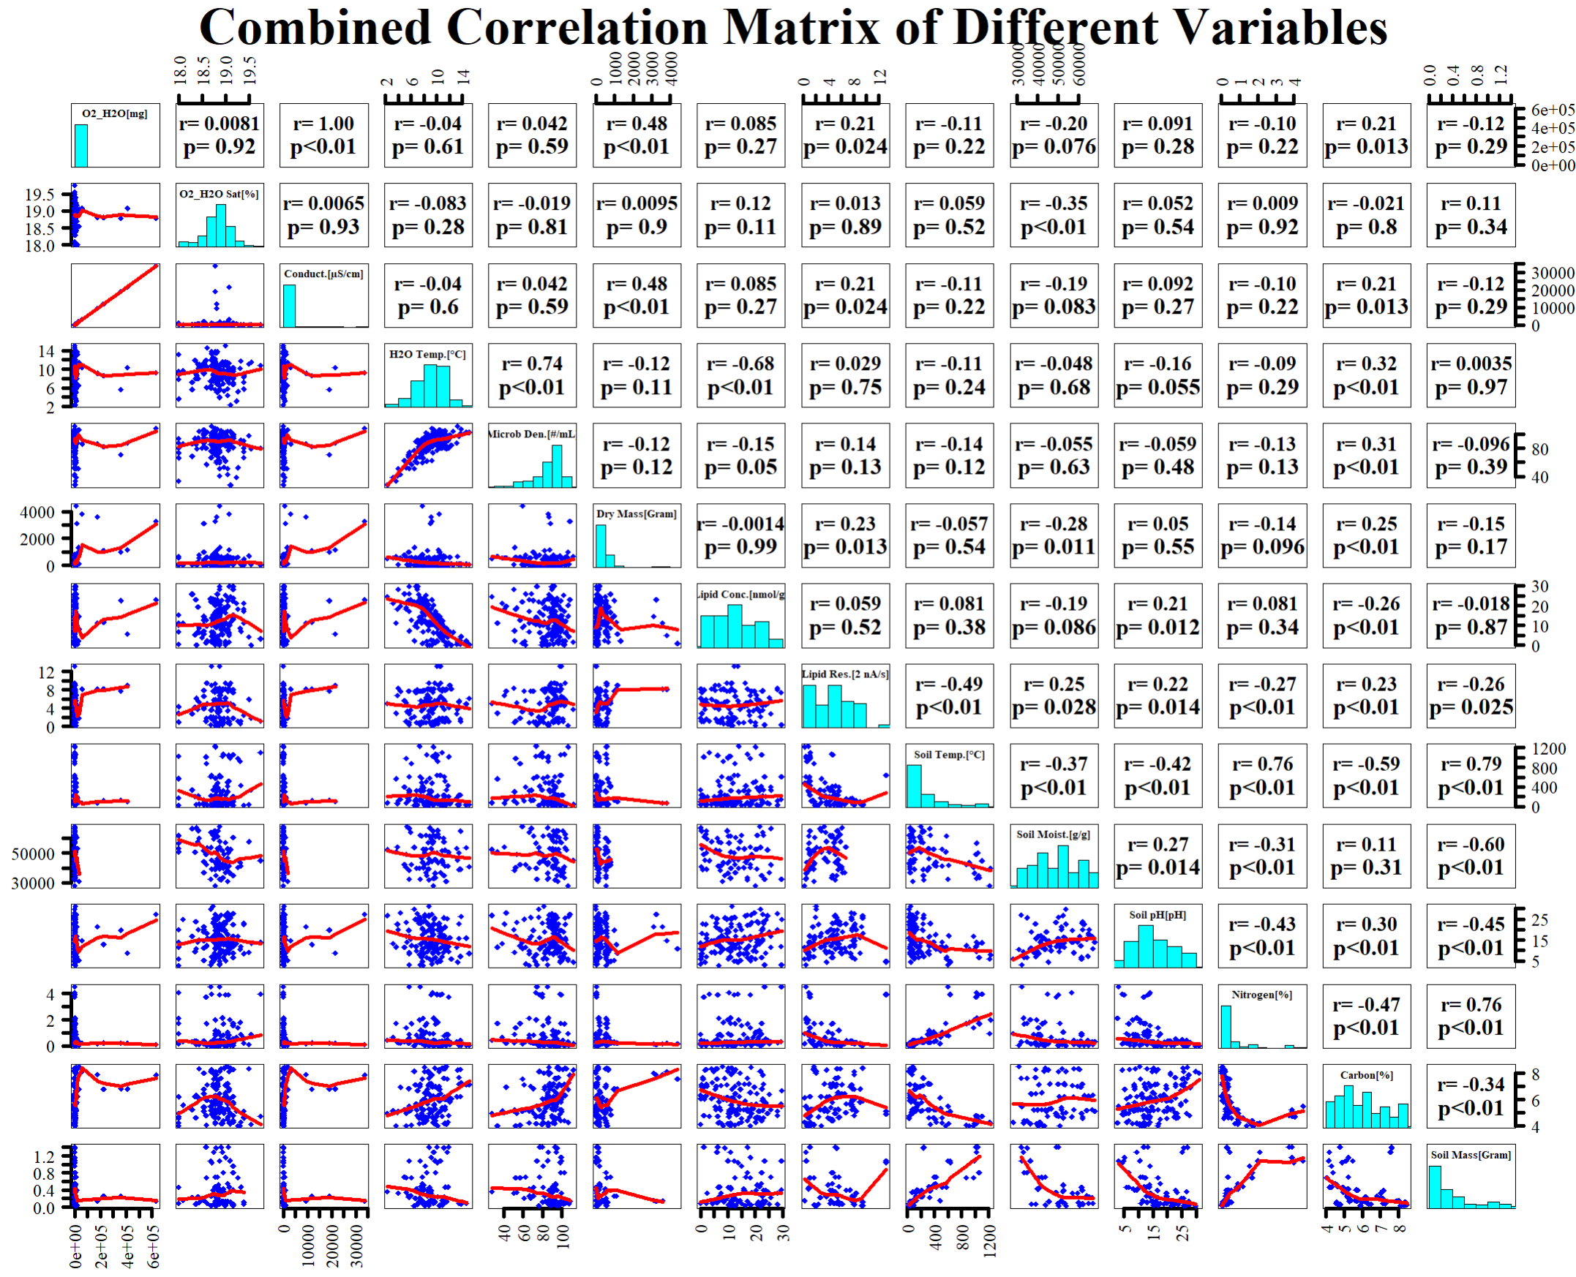
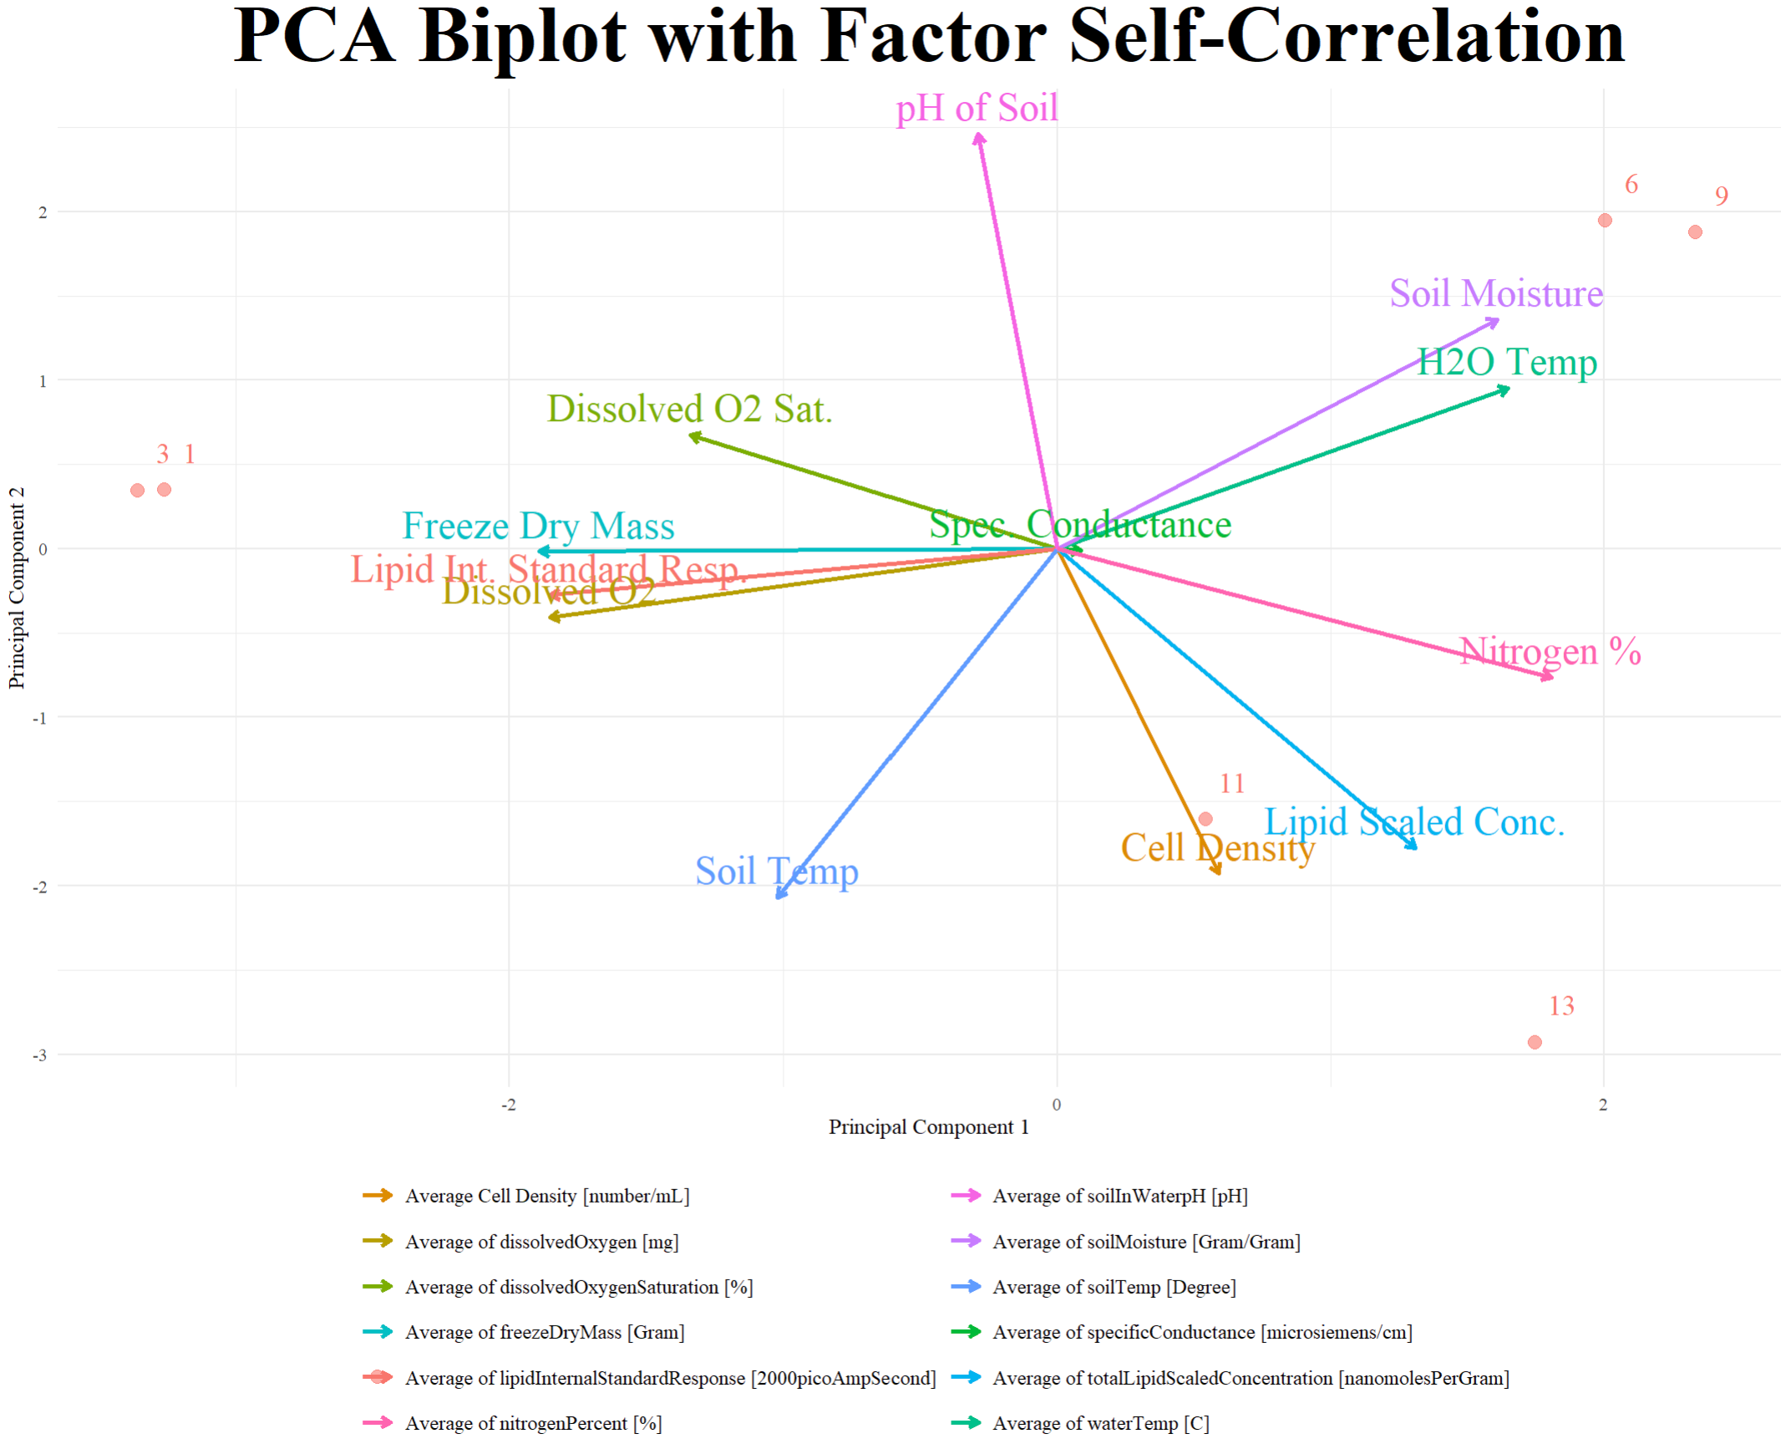
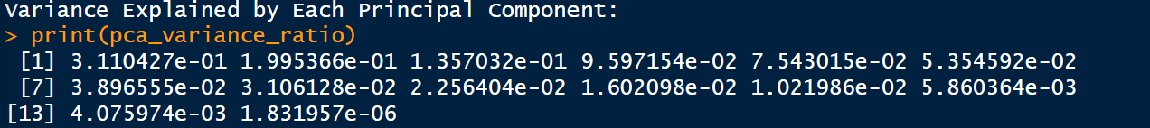
Macroecology of microbial abundance in soil and aquatic ecosystems across US
Contact Information:
Leo Sai¹ , David Lipson¹, Xiaofeng Xu¹
Email: lsai2907@sdsu.edu
1. Biology Department, San Diego State University, San Diego, CA, USA
Background
Results
Microbes drive and indicate climate change by influencing biomechanical feedback loops. This study explores the relationship between microorganisms and environmental factors like temperature, soil composition, pH, and moisture, using NEON Laboratories data to advance Green Microbiology for climate sustainability.
Methodology
In the terrestrial ecosystem, a strong correlations between SFM and CRP (0.97) and CRP and NTP (0.93), indicating a strong relationship between carbon percentage, soil fresh mass, and nitrogen percentage, offering insight into the carbon and nitrogen cycles.
In the aquatic ecosystem, a strong negative relationship between water temperature (WtT) and dissolved oxygen (dsO) (-0.68), and a positive relationship between dissolved oxygen (dsO) and oxygen saturation (DOS) (0.74).
Questions
How are microbial communities similarly affected in aquatic and terrestrial ecosystems?
Which ecosystem has the most diverse microbial communities in the US?
Which ecosystem plays a dominant role in climate change, and what is the main contributing factor?
Conclusion
Microorganisms play a key role in biomechanical processes affecting climate change, with significant declines in diversity across aquatic and terrestrial ecosystems.
Water temperature and specific conductance drive the carbon cycle, while soil moisture and temperature impact the nitrogen cycle, influencing microbial activity and ecosystem processes.
Future Directions
Further studies should examine seasonal changes in microorganism abundance across the US and their impact on environmental factors to enhance sustainability through Green Microbiology.
References and Acknowledgments
However, MCD, Spec Conductance, and H2O temp are the primary factors influencing the microbial communities across ecosystems.
This study has been supported by an NSF CAREER project (2145130). We acknowledge the operation of the NEON supported by the NSF.
Notes:
Put acknowledgment on right side. This is what I did and what I I do and continue talking if more interested

